Slide 1
Addressing Adverse Childhood Experiences in Native American Communities
Understanding Impacts and Implementing Strategies
Neil Tift
Outreach Project Coordinator
Native American Fatherhood and Families Association (NAFFA)

Slide 2
Introduction to ACEs
The Adverse Childhood Experiences Study (ACE Study) is a research study conducted by the American health maintenance organization Kaiser Permanente and the Centers for Disease Control and Prevention.
Participants were recruited to the study between 1995 and 1997 and have been in long-term follow up for health outcomes.
The study has demonstrated a strong correlation between adverse childhood experiences (ACEs) and significant health and social problems as an adult.

Slide 3


Slide 4
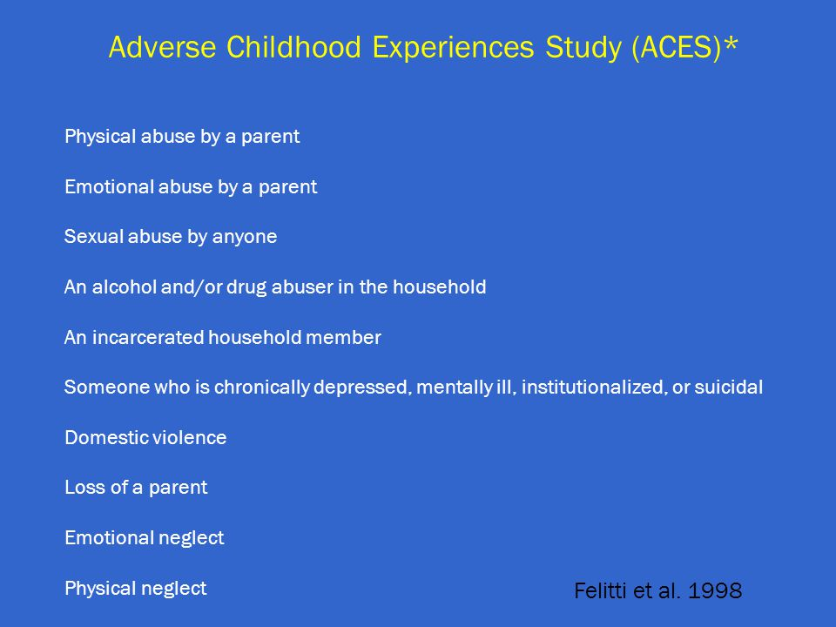

Slide 5
Introduction to ACEs
Data from a 2008 survey shows that ACEs are common in Arizona. In fact, more than half (57.5%) of Arizona adults have experienced at least one ACE.
The number of ACEs is tied to income level, family structure, ethnicity, insurance status and the educational attainment of adults in the household.
A recent study found that one Arizonan in four has experienced one ACE. One in three has experienced two or more. That is to say, more Arizonans report multiple ACEs than those who report just one.

Slide 6
Introduction to ACEs
High-quality nurturing caregiving—safe, stable, nurturing relationships—can actually change the structure of children’s brains, and that is why early detection is really important.
Economic hardship and divorce or separation of a parent or guardian are the most common ACEs reported nationally, and in all states.

Slide 7
Introduction to ACEs
From a survival perspective, the body can respond to perceived or actual threats with the “fight or flight” stress response.
However, if this threat is constant over a prolonged period of time, the endocrine and neuron systems stay activated, which can overtax the child and prevent the body from establishing stability, centeredness and a sense of self.

Slide 8
ACEs among Native Americans
In the report, “A Framework to Examine the Role of Epigenetics in Health Disparities among Native Americans,” the authors state, “Native Americans disproportionately experience ACEs and health disparities, significantly impacting long-term physical and psychological health.
In addition to these experiences, the persistence of stress associated with discrimination and historical trauma may add immeasurably to these challenges.”

Slide 9
ACEs among Native Americans
Exposure to ACEs among children varies by demographic characteristics, including race and ethnicity, parental education, and income level.
The proportion of children who had experienced two or more ACEs was highest among:
non-Hispanic American Indian/Alaska Native children, of whom two-fifths (40.3 percent) had experienced two or more of these ten life events.
non-Hispanic Black children and non-Hispanic children of multiple races, of whom about one-third had experienced such events (31.1 and 32.7 percent, respectively).

Slide 10
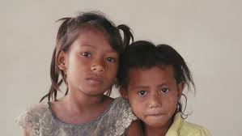
ACEs among Native Americans
ACEs disrupt a child’s sense of safety and the nurturing they need to develop, thrive and learn.
ACEs also include being judged or treated unfairly due to their race or ethnicity and living in homes where parents have difficulty getting by on their income.
Most children with any one ACE have at least one other.

Slide 11
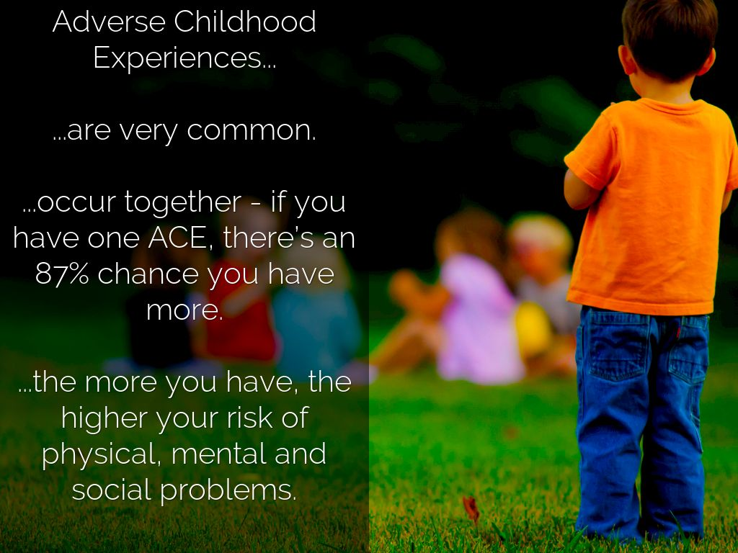

Slide 12
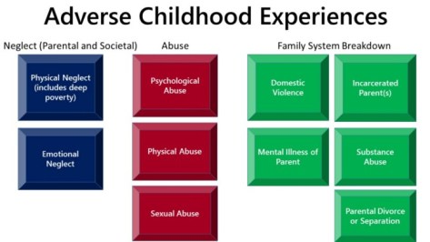

Slide 13
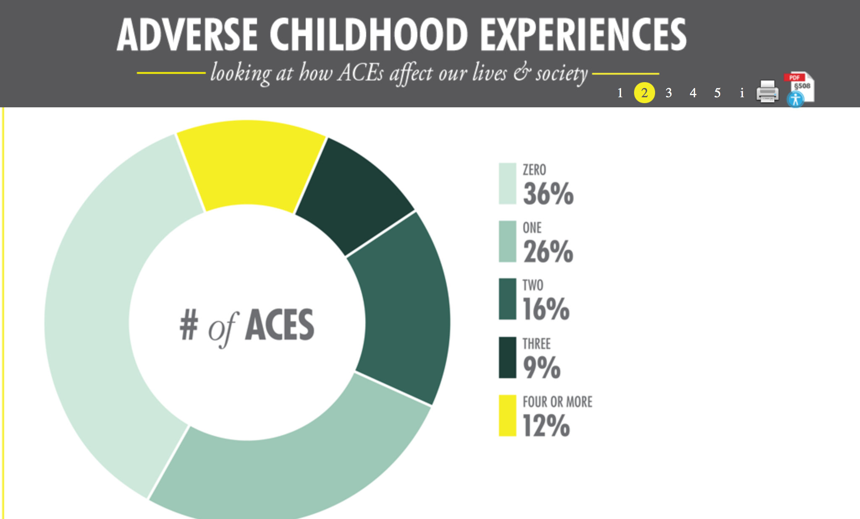

Slide 14
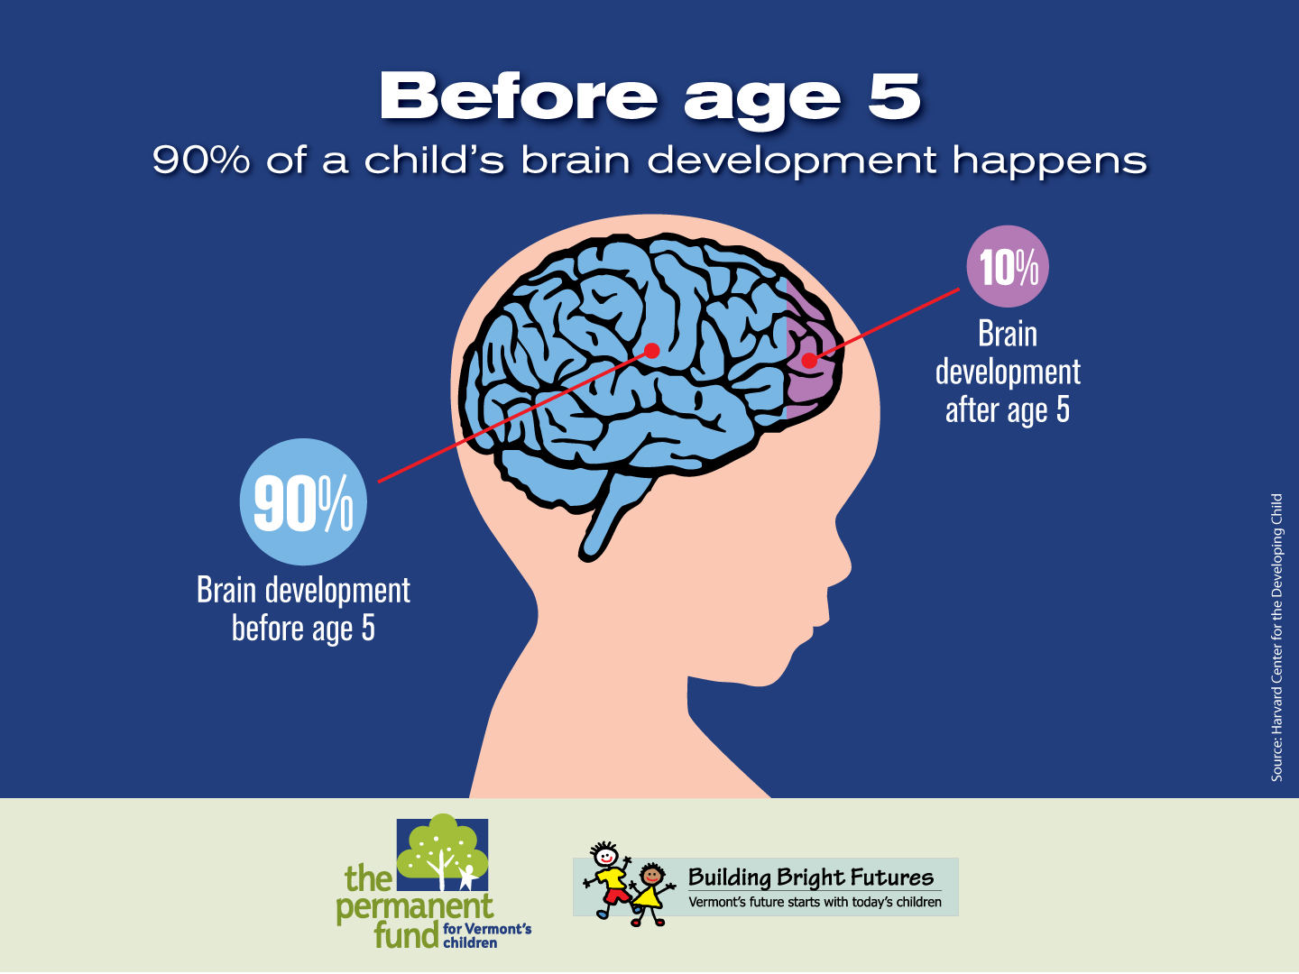

Slide 15
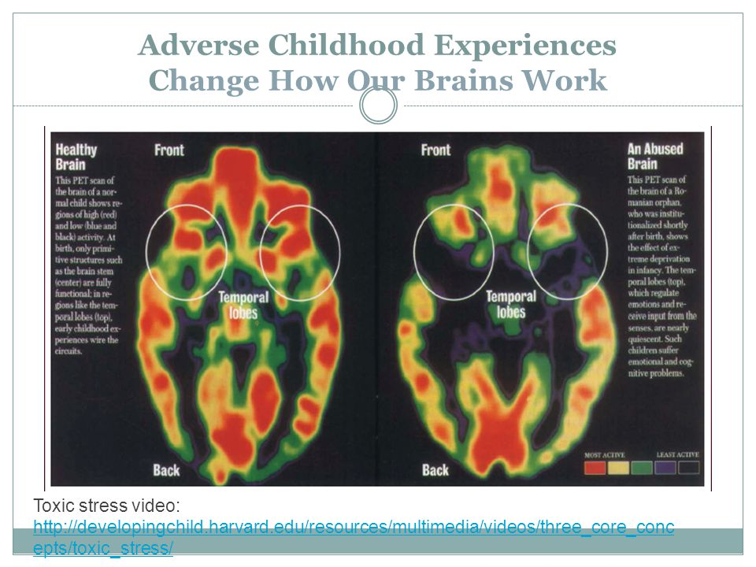

Slide 16
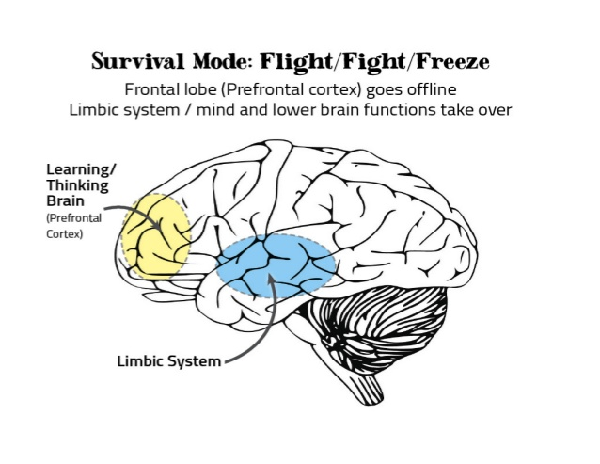

Slide 17
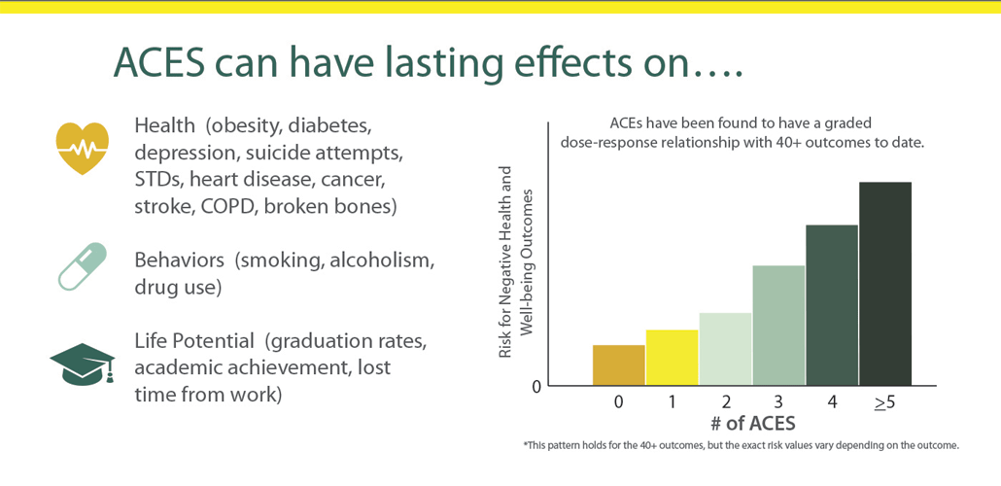

Slide 18
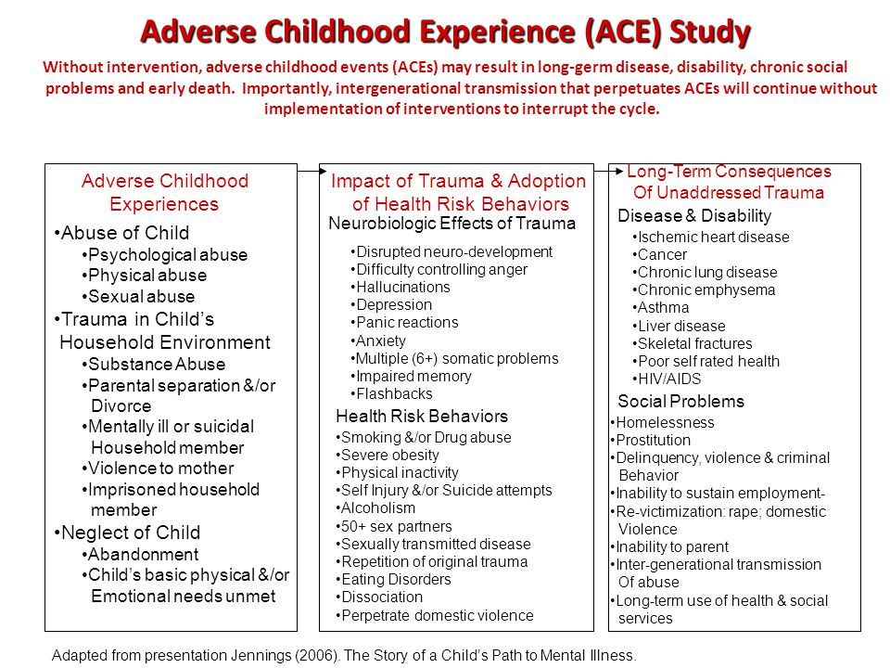

Slide 19
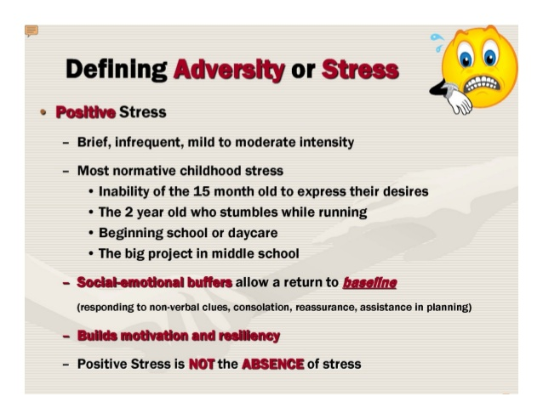

Slide 20
Impact of Stress upon Children
Children who are exposed to adverse childhood experiences may become overloaded with stress hormones, leaving them in a constant state of arousal and alertness to environmental and relational threats.
As a result, they may have difficulty focusing on school work and consolidating new memory, making it harder for them to concentrate on tasks and to learn at school.
One suggestion is to assist children in helping them to distinguish between good stress and bad stress in their lives.
.

Slide 21

Impact of Stress upon Children
Fight, flight or fright (freeze) response
Short attention span
Struggle learning (fall behind in school)
Respond to world as constant danger
Distrustful of adults
Unable to develop healthy peer relationships

Slide 22
NAFFA’s approach to addressing ACE’s
In order to permanently reduce the negative impact of adverse childhood experiences, NAFFA suggests an approach that has assisted thousands of fathers and mothers to grow happy and safe families.
Utilizing the Fatherhood Is Sacred™ and Motherhood Is Sacred™ program, consider applying some of these elements.

Slide 23
The purpose of life:
To have a happy and safe family
The purpose of NAFFA:
To strengthen and keep families together
To promote responsible fatherhood and motherhood to bring unity to our Native Nations
Everyone has the power to change their attitude and behavior but no one has the power to change anyone else.

Slide 24
Precisely, Our Method Is:
Uplifting: one’s spirit, attitude, self-image, self-worth, feeling welcome, wanted, needed and special
Encouraging: strengthening hope, bringing new hope, inspiring a desire for change, confidence and trust in self and others
Assisting: with recognizing opportunities, identifying resources, improving life skills and problem solving abilities
Teaching: principles, responsibilities toward family, fatherhood, motherhood, marriage, and self-control

Slide 25
Promote Choice
Next to life, the greatest possession we have is the right to choose
Choice: freedom to act for yourself
Self-respect: the right to make your own choices
Respect for others: allowing others to make their own choices

Slide 26
Encourage Change
Real and lasting change must come from within through feeling
Outside pressure rarely brings lasting change Example: knowledge, preaching, intimidation, etc.
Change comes by filling life with hope, gratitude, & understanding and has a powerful affect on changing attitude and behavior

Slide 27
Focus upon Positives
ACE scores don't tally the positive experiences in early life that can help build resilience and protect a child from the effects of trauma.
Research indicates that having a grandparent who loves you, a teacher who understands and believes in you, or a trusted friend that you can confide in may mitigate the long-term effects of early trauma.

Slide 28

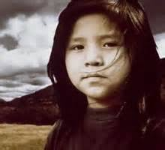
Techniques to Help a Child
First, we must be aware of some of the most important messages from your culture, your family, your clan that you want to instill in your children? How do you want to do that?

Slide 29
Techniques to Help a Child
When working with children who are dealing with the impact of adverse childhood experiences, try an approach that does not focus on a skill set as much as it focuses on a mind set.
The mind set to working with Native children and adults is to try to understand and appreciate core elements of the influential messages that children receive and internalize as a result of their cultural identity, family heritage and first language.

Slide 30
Techniques to Help a Child
Identify children at risk through routine screening or surveillance.
Assess family strengths and assets as well as challenges to help identify needs for specific services and/or supports in the future.
Establish relationships with community resources that address trauma in children.
Create a comprehensive list of community resources available (local United Way organizations often are a good start).

Slide 31
Techniques to Help a Child
Locate or develop support groups that center upon specific needs of the children, including emotional management, transitions and grief and loss.
Recruit and train mentors who are older adolescents or young adults with proven skills in working with children in need.
Promote investment in local programs that focus upon helping others to heal.

Slide 32
Techniques to Help a Child
Sponsor opportunities for children and adolescents to enhance their self-care skills.
Locate and participate in culturally-based classes for children that promote protective factors.
Help the child develop a coping skills booklet or similar tool.

Slide 33
Techniques to Help a Child
Write down what is bothering the child and majestically throw it away.
Create an obstacle course or build a fort.
Talk to someone they trust
Cook or bake something good.
Offer artistic opportunities for child to express their situations in a safe manner.

Slide 34
Techniques to Help a Child
Offer opportunities for children of all ages to enhance their coping skills, such as:
Help them give words to their feelings
Recognize the child’s triggers
Stick with what they love to do (to cope)
Model active listening
Ask open-ended questions
Help them engage the five senses

Slide 35
Techniques to Help a Child
Decide how to help children through transitions
Be present during important times
Redirect the child during stressful times with humor, music, reading, games, toys, sports.
Offer opportunities to express feelings through finger painting, drawing, molding clay and other physically artistic expressions.
Encourage child to play with a pet

Slide 36
Techniques to Help a Child
Promote assertiveness skills. Give children ample opportunities to:
Say “no” to others
Feel and express anger in safe ways
Express their needs, thoughts, emotions and ideas
Ask for help when needed
Feel supported
Be proud of their accomplishments

Slide 37
Techniques to Help a Child
Listen to and explore the child’s self talk. If it is primarily negative or put-downs, offer them suggestions on how to shift to more positive self talk.
Learn how to differentiate a child having a fear response from one who is just being willful or difficult.
Explore age-appropriate techniques that promote and enhance resiliency skills in children.

Slide 38

Techniques to Help a Child
Remember, it’s not the child’s fault
Do not ask: “What’s wrong (with you)?
Rather ask: Can you tell me what happened to you?

Slide 39
Techniques to Help a Child
To overcome adversities, children draw from three sources of resilience features labelled:
I HAVE
I AM
I CAN.
What they draw from each of the three sources may be described as follows:

Slide 40
Techniques to Help a Child
I HAVE
People around me I trust and who love me, no matter what
People who set limits for me so I know when to stop before there is danger or trouble
People who show me how to do things right by the way they do things
People who help me when I am sick, in danger or need to learn

Slide 41
Techniques to Help a Child
I AM
A person people can like and love
Glad to do nice things for others and show my concern
Respectful of myself and others
Willing to be responsible for what I do
Sure things will be all right

Slide 42
Techniques to Help a Child
I CAN
Talk to others about things that frighten me or bother me
Find ways to solve problems that I face
Control myself when I feel like doing something not right or dangerous
Figure out when it is a good time to talk to someone or to take action
Find someone to help me when I need it *

Slide 43
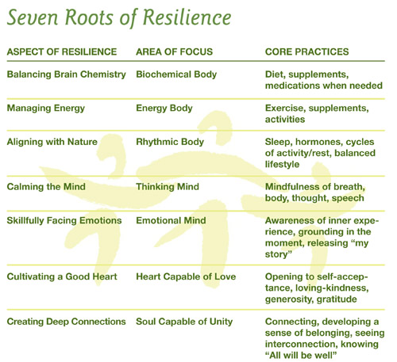

Slide 44
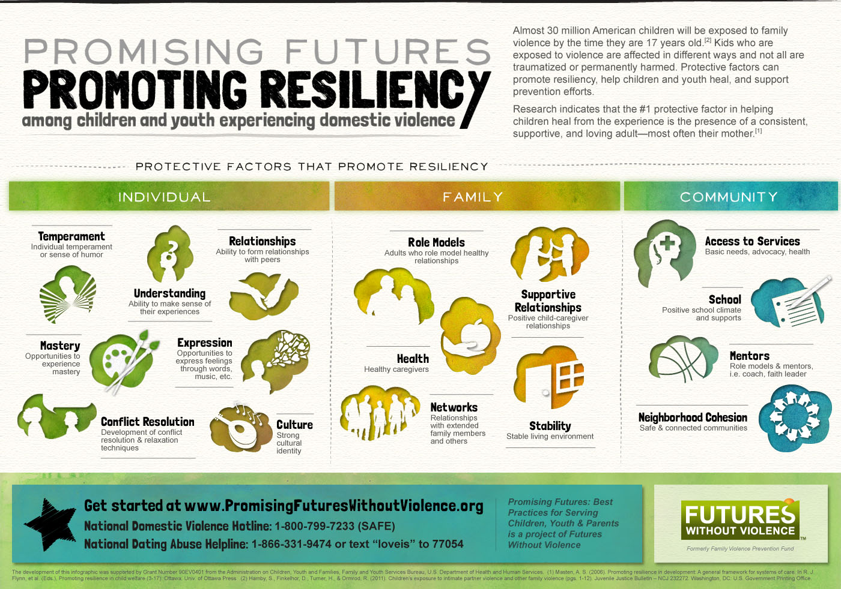

Slide 45
Techniques to Help a Child
To counter the impact of adverse childhood experiences, consider applications of the protective factors. These include
Knowledge of parenting and of child and youth development
Parental resilience
Social connections
Concrete supports for parents
Social and emotional competence of children

Slide 46
Techniques to Help a Child
Exercise
In small group discussion, list several steps that you could take to enhance the application of one or more of the five protective factors in the families with whom you work.

Slide 47
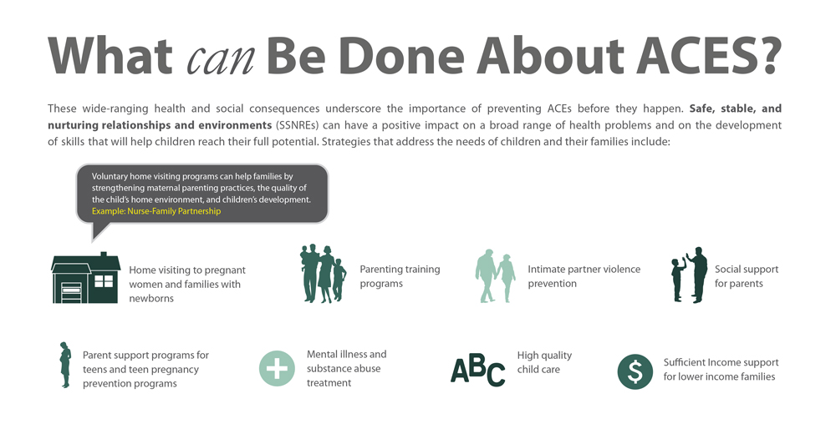

Slide 48
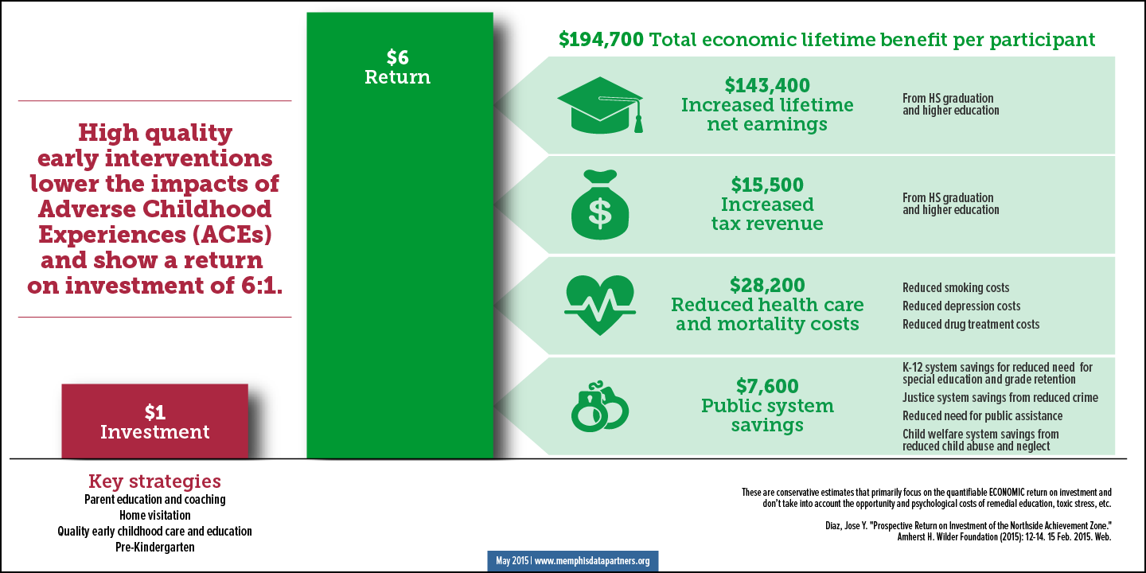

Slide 49
ACEs Impact Upon Adults
It is generally understood that ACE scores between 4 and 10 can explain why we have chronic disease or identify those at risk for developing chronic diseases.
Knowing our ACEs score is as important as knowing our cholesterol scores.
Knowing can help us take steps to change or prevent behavior likely to result in disease and it can help us to prevent it in our children as well to ensure their healthy development.

Slide 50

ACEs Impact Upon Adults
In a 2015 Indian Health Service (IHS) report, “Trends in Indian Health,” finds that American Indians are 638% more likely to suffer from alcoholism compared to the rest of the U.S. population.
The impact of this addiction obviously impacts healthy child development and parent child relationships.

Slide 51
ACEs Impact Upon Adults
Adults who have experienced ACEs in their early years may exhibit reduced parenting capacity or maladaptive responses to their children.
The physiological changes that have occurred to the adult’s stress response system as a result of earlier trauma can result in diminished capacity to respond to additional stressors in a healthy way.

Slide 52
ACEs Impact Upon Adults
Adverse childhood experiences increase the chance of social risk factors, mental health issues, substance abuse, intimate partner violence, and adult adoption of risky adult behaviors.
All of these can affect parenting in a negative way and perpetuate a continuing exposure to ACEs across generations to come.

Slide 53
ACEs Impact Upon Adults
Trauma not only effects those who directly experience it, but also those in the generations that follow.
Dr. Maria Yellow Horse Brave Heart describes historical trauma as the “cumulative emotional and psychological wounding across generations, including the lifespan, which emanates from massive group trauma.”

Slide 54
Promote and pursue healthy change
Real and lasting change must come from within through feeling.
Outside pressure rarely brings lasting change Example: knowledge, preaching, intimidation, etc.
Change comes by filling life with hope, gratitude, & understanding and has a powerful affect on changing attitude and behavior

Slide 55
Techniques to Help an Adult
Promote parents seek "trauma informed" therapy, which may center upon art, yoga, exercise, mindfulness training and many other options.
Identify resources in the community that offer parent education classes and workshops to help parents identify and attend to their issues.
Make classes and workshops available to staff and parents that promote healthy problem-solving, conflict resolution and emotional management.

Slide 56
Techniques to Help an Adult
Help parents understand the detrimental and dangerous effect of spanking and other forms of corporal punishment on their children.
When considering job placement assistance, seek employment in businesses with family-friendly policies and practices.
Locate and place children in culturally enriching child care centers and pre-school programs.

Slide 57
Techniques to Help an Adult
Promote healthy assertiveness skills to;
Enhance awareness of their emotions and desires.
Identify areas where they are comfortable speaking up for themselves and where they are not.
Face their fears and practice being assertive with moderate self-exposure.

Slide 58
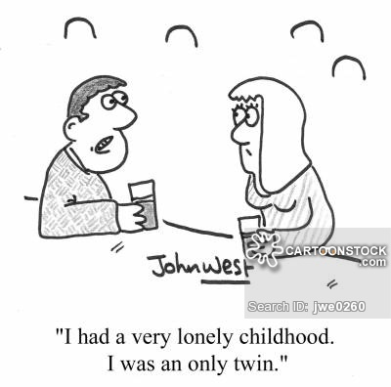

Slide 59
Techniques to Help an Adult
Enhance healthy parenting by encouraging families to request tribal-based home visiting services.
Encourage adults to seek positive inputs – like calming music, unprocessed foods, sweats and walks through nature – to stimulate their system to regulate in favorable ways.

Slide 60
Techniques to Help an Adult
Explore multigenerational approaches to recognize problems and pursue healing activities and attitudes.
Support programs that encourage attachment, healthy relationships and culturally-based therapeutic interventions.
Promote trauma-informed workforce, schools, and communities.

Slide 61
Conclusion
As you review the content of this workshop, select three to five points raised that you want to apply to the families with whom you work.
How do you want accomplish this?

Slide 62
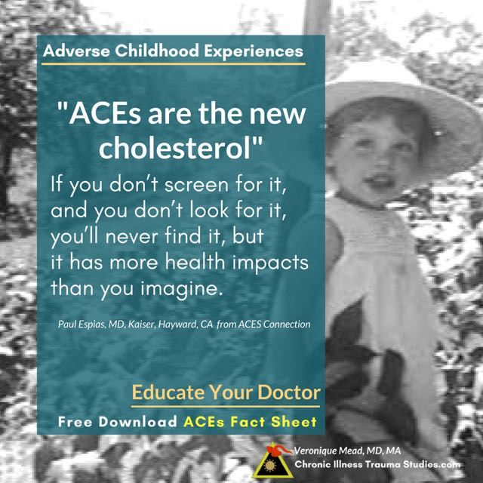

Slide 63
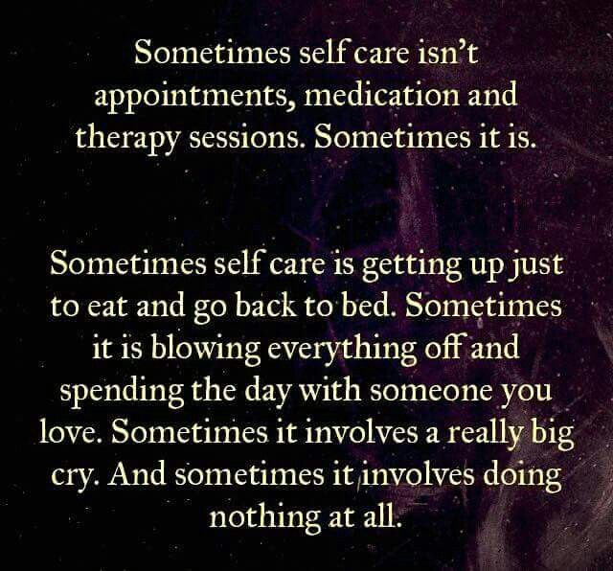
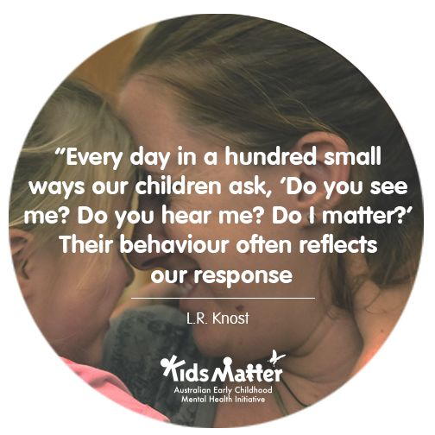

Slide 64
Conclusion
“Humankind has not woven the web of life. We are but one thread within it. Whatever we do to the web, we do to ourselves. All things are bound together. All things connect.” ~Chief Seattle, Duwamish
Don’t be afraid to cry. It will free your mind of sorrowful thoughts. ~Hopi
“Tell me and I’ll forget. Show me, and I may not remember. Involve me, and I’ll understand.” ~ Tribe Unknown

Slide 65
Conclusion
“The greater a child’s terror, and the earlier it is experienced, the harder it becomes to develop a strong and healthy sense of self.” ~Nathaniel Branden, Six Pillars of Self-Esteem.
“If the sound of happy children is grating on your ears, I don't think it's the children who need to be adjusted.” ~Stefan Molyneux
“If you carry your childhood with you, you never become older.” ~Tom Stoppard

Slide 66
Conclusion
“When you were born, you cried and the world rejoiced. Live your life so that when you die, the world cries and you rejoice.” ~ Cherokee
“If we wonder often, the gift of knowledge will come.” ~ Arapaho
“Everyone who is successful must have dreamed of something.” ~ Maricopa saying
“He who would do great things should not attempt them all alone.” ~ Seneca

Slide 67
Conclusion
“We will be known forever by the tracks we leave.” ~ Dakota
“You have to look deeper, way below the anger, the hurt, the hate, the jealousy, the self-pity, way down deeper where the dreams lie, son. Find your dream. It’s the pursuit of the dream that heals you.” ~ Billy Mills
“You already possess everything necessary to become great.” ~ A Crow saying

Slide 68
Sources of Information
Slides 35-37 “A Guide to Promoting Resilience in Children.” by Edith Groberg, Ph.D. 1995 International Resilience Project.
Slide 39 Henry Emmons, @partnersinresilience.com
Slides 49-50 “The Impact of Historical and Intergenerational Trauma on American Indian and Alaska Native Communities, November 25, 2015. SAMHSA

Slide 69
Sources of Information
Slide 5. Injury Prevention Center, Strong Families, Phoenix Children’s Hospital
Slides 8-9. “A Framework to Examine the Role of Epigenetics in Health Disparities among Native Americans,” by Teresa N. Brockie, Morgan Heinzelmann and Jessica Gill, Nursing Research and Translational Science, National Institutes of Health, Bethesda, MD. 2013,

Slide 70
Presenter
Neil Tift
Outreach Project Coordinator
Native American Fatherhood and
Families Association (NAFFA)
460 North Mesa Drive
Suite 115
Mesa, AZ. 85201
480.833.5007
neilt@aznaffa.org

